Slide 1
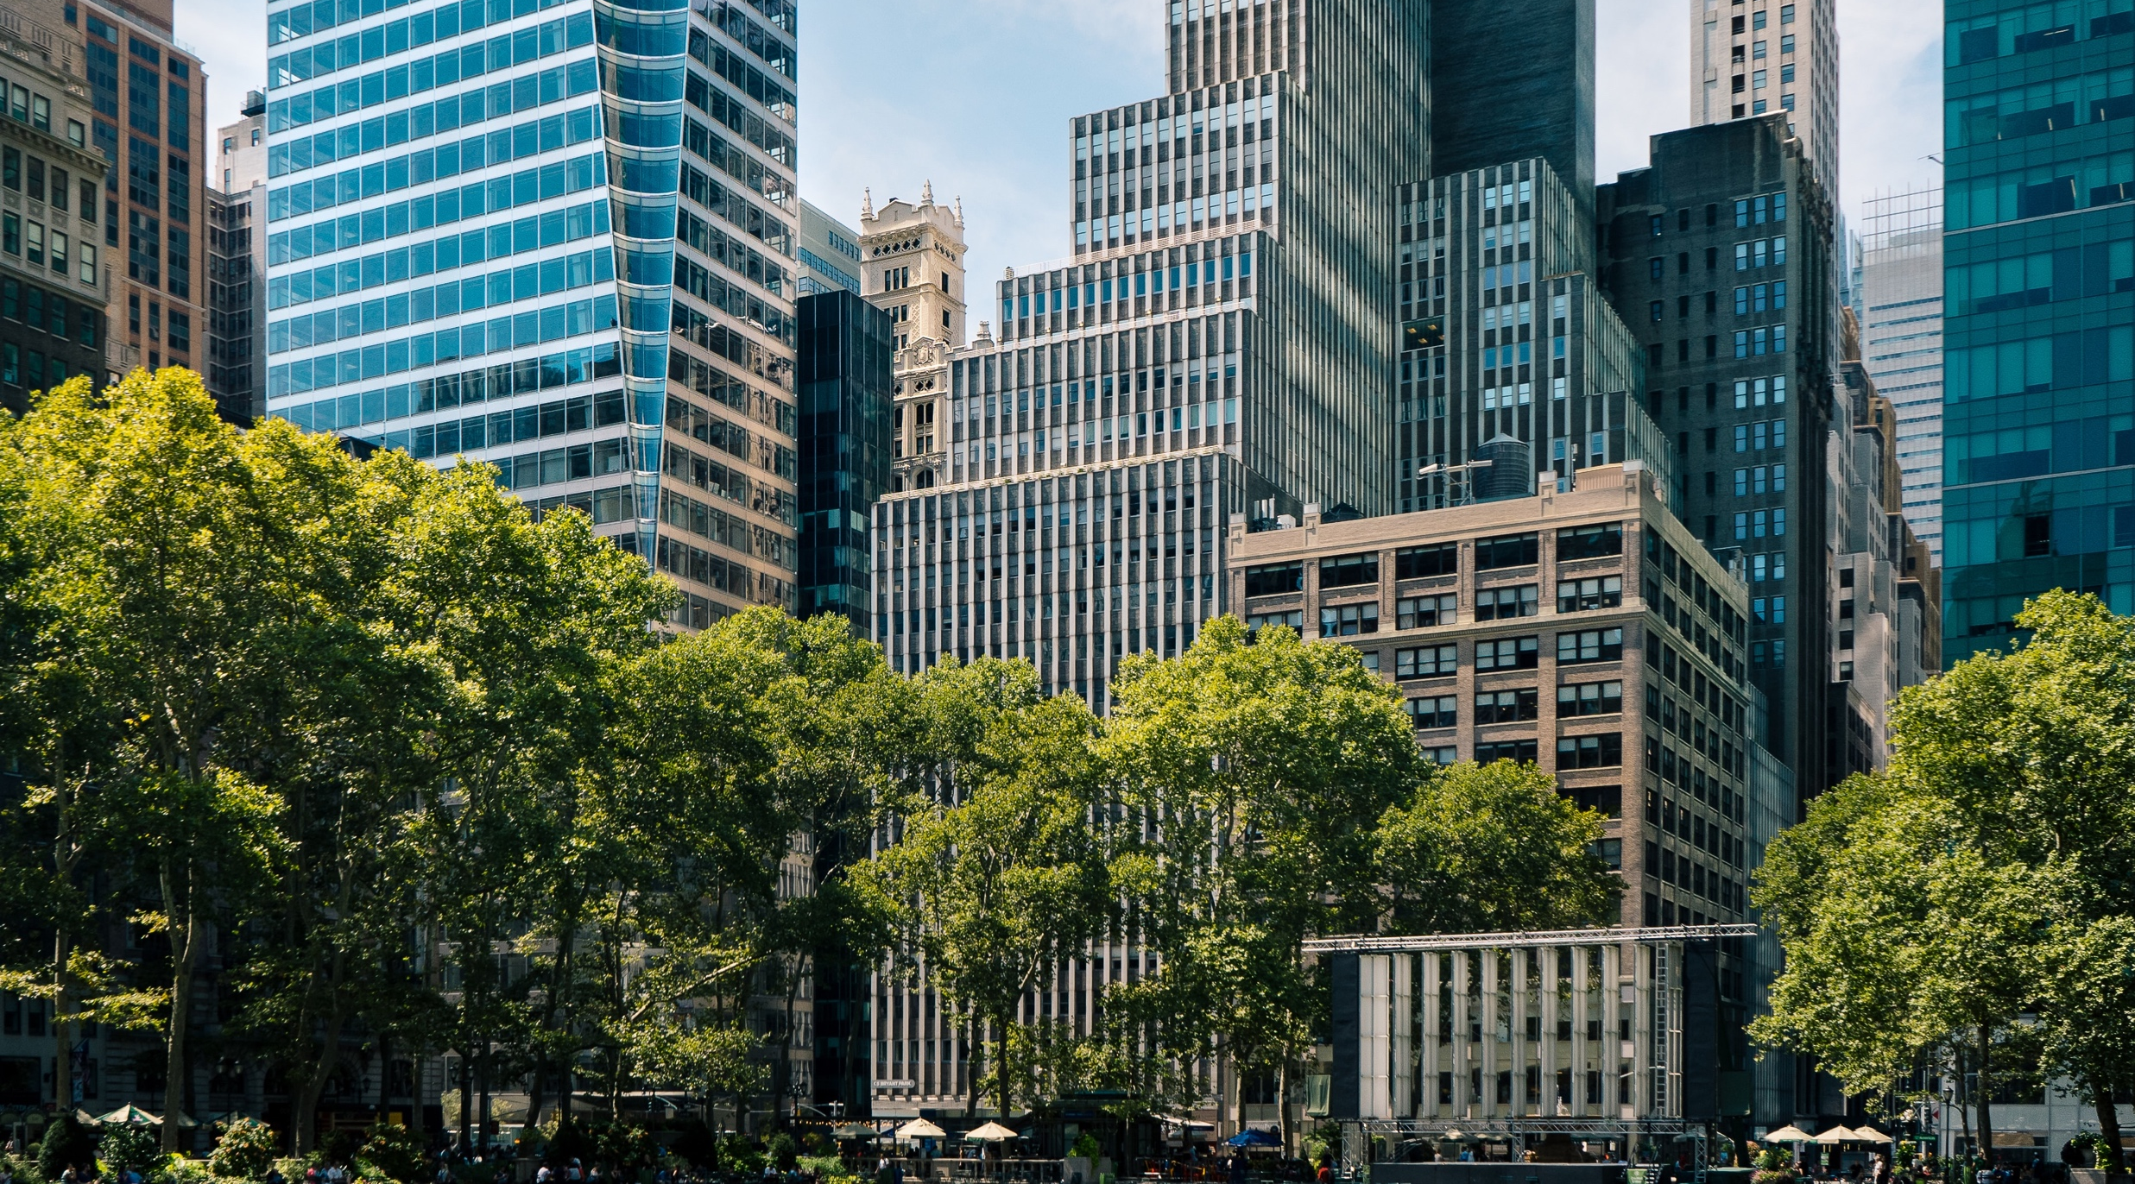
If it’s broke, fix it! The Right to Repair in a Hyper-Smart World
December 8, 2021 | Sustainability Matters
© 2021 Business for Social Responsibility
Notes:
“Thank for you dialing in, our call will begin in approximately 5 minutes.”
“Thank you for your patience, we still have participants joining in, we will begin shortly.
I want to welcome you to our webinar “If it’s broke, fix it: the right to repair in a hyper-smart world,” a part of our Sustainability Matters series that takes place at least once per month and allows you, our members, to engage in dialogue with BSR experts and your peers on today's corporate responsibility challenges and solutions.
I’m Nicole Pamani, an Associate here at BSR with experience in the circular economy, and your host for today’s session.

Slide 2
Agenda
Wednesday December 8th: 11am – 12pm ET
Welcome (5 mins)
Speaker Introductions (10 mins)
Panel Discussion (20 mins)
Audience Q&A (15 mins)
Closing (5 mins)
Notes:
Here is the agenda for today’s session.
I’ll kick us off with a brief refresher on the right to repair, then our speakers will introduce themselves, this will be followed by a 20 minute panel discussion before we open up to the audience for an interactive Q&A.
Some logistics:
During the discussion, all participants will be in listen-only mode.
During the Question and Answer session, if you are listening in on your computer, you can submit questions at any time by clicking Q&A. Type your question in the box and click the SEND button.
Please note that we are audio recording this event so that BSR members who couldn’t join us will be able to enjoy it later.

Slide 3
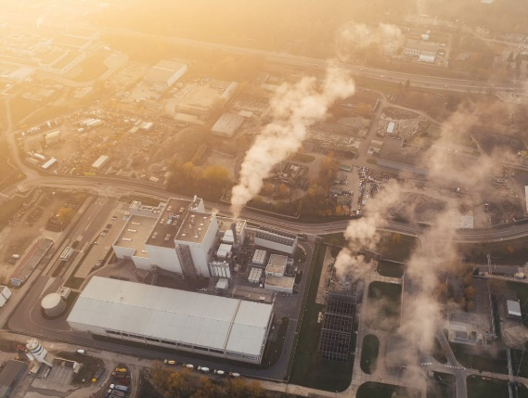
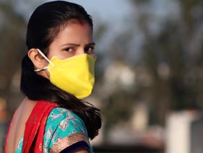
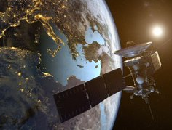
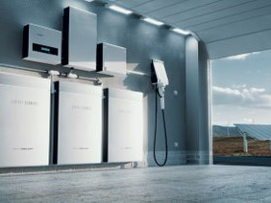
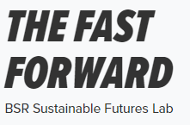
The Fast Forward – BSR Sustainable Futures Lab
In the latest edition of THE FAST FORWARD, BSR's Sustainable Futures Lab describes five emerging issues with the power to reshape sustainable business in the coming years. Discover how they will impact you, your company and society in the future.
__
Carbon Trade Wars?
__
The Workforce Challenge of Long COVID
__
Satellites Remaking Supply Chains
__
A Scramble for Battery Minerals
__
The Global Population Slowdown
THE FAST FORWARD, a quarterly publication produced by the BSR Sustainable Futures Lab, explores emerging issues at the nexus of business and sustainability.
Notes:
This webinar is a follow-up to an article published earlier this year in The Fast Forward.
The Fast Forward is BSR’s quarterly publication that explores emerging issues at the nexus of business and sustainability. Each edition focuses on nascent trends within sustainability but also in the macro environment that are likely to impact business by disrupting the future and that will require a robust and forward-looking sustainability strategy to navigate.

Slide 4
The Right to Repair
We’ve embedded electronics into everything, from our cars to our clothes, but our ability to repair these items has steadily declined. Products that cannot be repaired generate waste, contribute to resource scarcity, and undermine consumer value. Emerging legislation in the EU and the US is putting pressure on manufacturers to respect consumers’ right to repair their electronics.
In today’s discussion we will explore:
The role of the right to repair in reducing resource use and enabling circularity
Opportunities and challenges the right to repair brings for companies across industries from technology to consumer products
Implications for workers and communities in the supply chain
Opportunities to further enable repairability, recyclability, and circularity for smart products
Notes:
So what is the right to repair and why does it matter?
It’s no secret that we’ve embedded electronics into every facet of life – from our cars to our clothes – but what has increasingly diminished, is our right to repair these items.
Planned obsolescence, combined with software locks and restricted access to manuals and parts, has made it more difficult and expensive to repair products – often forcing consumers to use specialist repair services that increase the cost, time, and unlikelihood of repair. Sometimes, repair is simply impossible.
Products that cannot be repaired implicitly generate waste, contribute to resource scarcity, and ultimately undermine consumer value.
The repair movement has gained momentum in recent years with support from repair trade associations, companies offering new modular designs, and emerging community networks for repairers, such as iFixit and physical repair cafes around the world. Together, these groups help to advance consumers’ ability to repair the items they own.
Even more telling, we’re seeing emerging legislation in the EU and US that is putting pressure on manufacturers to respect consumers’ right to repair their electronics

Slide 5
Speakers
Erika Chan
Kyle Wiens
Michael Rohwer
Nicole Pamani
Director of Corporate Sustainability, Dell
CEO, iFixit
Director, BSR
Associate, BSR

Slide 6
Thank you to our SPARK members
Notes:
We would also like to thank our SPARK members for their support and for making events like these possible.

Slide 7
BSR Upcoming Events
WEBINAR How to Enable a Just, Fair, and Inclusive Transition to Circular Fashion
December 9, 2021
WEBINAR The Launch of Climate Fit: Free and Easy-to-Access Training for SMEs on Carbon Reduction
December 15, 2021
WEBINAR | PARTNER EVENT Economist Impact Sustainability Week Asia
February 14-17, 2021
For a full list of upcoming events, visit: bsr.org/events
Notes:
Please join us again for our upcoming events. More information can be found at bsr.org/events.
After this webinar ends, you will see a survey pop-up in your browser. Please do take a moment to fill it out and provide your feedback so we can continue to improve our events.
You will also receive a follow-up email with a link to the presentation and audio recording.

Slide 8
Thank You
BSR™ is an organization of sustainable business experts that works with its global network of the world’s leading companies to build a just and sustainable world. With offices in Asia, Europe, and North America, BSR™ provides insight, advice, and collaborative initiatives to help you see a changing world more clearly, create long-term business value, and scale impact.
www.bsr.org
Notes:
Thank you again for joining us on this call today. These are the kind of discussions that reinforce the power of the BSR network to foster important connections and help us work together to create a just and sustainable world. We’ll see you next time.

